Slide 1
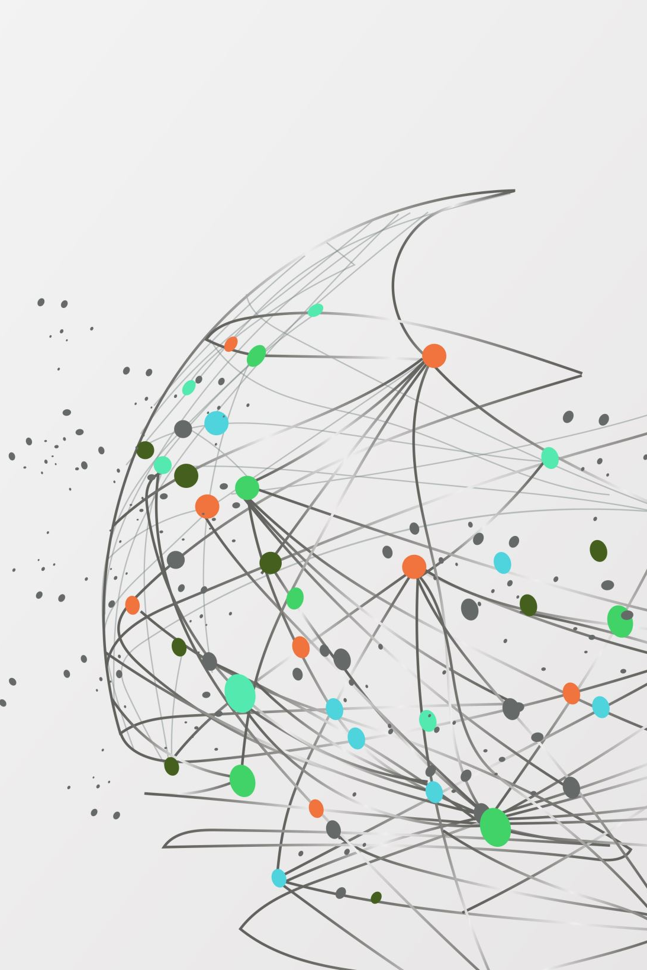
Introduction to Machine Learning
Musadaq Mansoor

Slide 2
Introduction
We have seen Machine Learning as a buzzword for the past few years, the reason for this might be the high amount of data production by applications, the increase of computation power in the past few years and the development of better algorithms.

Slide 3
History
In the 1950s, we see the first computer game program claiming to be able to beat the checkers world champion. This program helped checkers players a lot in improving their skills!
Around the same time, Frank Rosenblatt invented the Perceptron which was a very, very simple classifier but when it was combined in large numbers, in a network, it became a powerful monster. Well, the monster is relative to the time and in that time, it was a real breakthrough.
Then we see several years of stagnation of the neural network field due to its difficulties in solving certain problems.

Slide 4
History
Thanks to statistics, machine learning became very famous in the 1990s. The intersection of computer science and statistics gave birth to probabilistic approaches in AI.
This shifted the field further toward data-driven approaches. Having large-scale data available, scientists started to build intelligent systems that were able to analyze and learn from large amounts of data.
As a highlight, IBM’s Deep Blue system beat the world champion of chess, the grand-master Garry Kasparov. Yeah, I know Kasparov accused IBM of cheating, but this is a piece of history now and Deep Blue is resting peacefully in a museum.

Slide 5
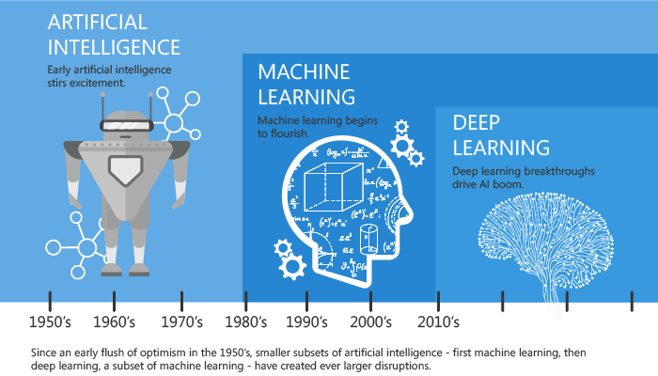

Slide 6
What is Machine Learning
According to Arthur Samuel, Machine Learning algorithms enable the computers to learn from data, and even improve themselves, without being explicitly programmed.
Machine learning (ML) is a category of an algorithm that allows software applications to become more accurate in predicting outcomes without being explicitly programmed.

Slide 7
Terminology
Dataset
A set of data examples, that contain features important to solving the problem.
Features
Important pieces of data that help us understand a problem. These are fed into a Machine Learning algorithm to help it learn.
Model
The representation (internal model) of a phenomenon that a Machine Learning algorithm has learnt. It learns this from the data it is shown during training. The model is the output you get after training an algorithm. For example, a decision tree algorithm would be trained and produce a decision tree model.

Slide 8
Process
Data Collection: Collect the data that the algorithm will learn from.
Data Preparation: Format and engineer the data into the optimal format, extracting important features and performing dimensionality reduction.
Training: Also known as the fitting stage, this is where the Machine Learning algorithm actually learns by showing it the data that has been collected and prepared.
Evaluation: Test the model to see how well it performs.
Tuning: Fine tune the model to maximize it’s performance.

Slide 9
Machine Learning Approaches
Supervised Learning
Unsupervised Learning
Semi-supervised Learning
Reinforcement Learning

Slide 10
Overview of Supervised Learning Algorithm
In Supervised learning, an AI system is presented with data which is labeled, which means that each data tagged with the correct label.
The goal is to approximate the mapping function so well that when you have new input data (x) that you can predict the output variables (Y) for that data.

Slide 11
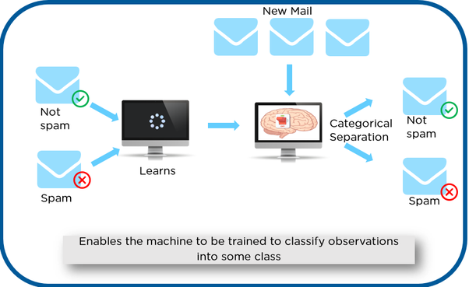

Slide 12
Overview of Supervised Learning Algorithm
As shown in the previous example, we have initially taken some data and marked them as ‘Spam’ or ‘Not Spam’. This labeled data is used by the training supervised model, this data is used to train the model.
Once it is trained we can test our model by testing it with some test new mails and checking of the model is able to predict the right output.

Slide 13
Types of Supervised Learning
Classification: A classification problem is when the output variable is a category, such as “red” or “blue” or “disease” and “no disease”.
Regression: A regression problem is when the output variable is a real value, such as “dollars” or “weight”.

Slide 14
Overview of Unsupervised Learning Algorithm
In unsupervised learning, an AI system is presented with unlabeled, uncategorized data and the system’s algorithms act on the data without prior training.
The output is dependent upon the coded algorithms. Subjecting a system to unsupervised learning is one way of testing AI.

Slide 15
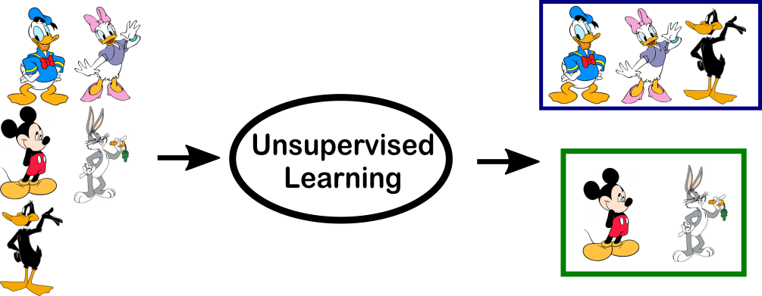

Slide 16
Overview of Unsupervised Learning Algorithm
In the above example, we have given some characters to our model which are ‘Ducks’ and ‘Not Ducks’. In our training data, we don’t provide any label to the corresponding data.
The unsupervised model is able to separate both the characters by looking at the type of data and models the underlying structure or distribution in the data in order to learn more about it.

Slide 17
Types of Unsupervised learning
Clustering: A clustering problem is where you want to discover the inherent groupings in the data, such as grouping customers by purchasing behavior.
Association: An association rule learning problem is where you want to discover rules that describe large portions of your data, such as people that buy X also tend to buy Y.

Slide 18
Overview of Semi-supervised learning
Semi-supervised learning is a mix between supervised and unsupervised approaches.
By being able to mix together a small amount of labelled data with a much larger unlabeled dataset it reduces the burden of having enough labelled data. Therefore, it opens up many more problems to be solved with machine learning.

Slide 19
Overview of Semi-supervised learning
Generative Adversarial Networks
Generative Adversarial Networks (GANs) have been a recent breakthrough with incredible results. GANs use two neural networks, a generator and a discriminator. The generator generates output, and the discriminator critiques it. By battling against each other they both become increasingly skilled.
Examples
A perfect example is in medical scans, such as cancer scans. A trained expert is needed to label these which is time-consuming and very expensive. Instead, an expert can label just a small set of cancer scans, and the semi-supervised algorithm would be able to leverage this small subset and apply it to a larger set of scans.

Slide 20
Overview of Reinforcement Learning
A reinforcement learning algorithm, or agent, learns by interacting with its environment. The agent receives rewards by performing correctly and penalties for performing incorrectly.
The agent learns without intervention from a human by maximizing its reward and minimizing its penalty. It is a type of dynamic programming that trains algorithms using a system of reward and punishment.

Slide 21
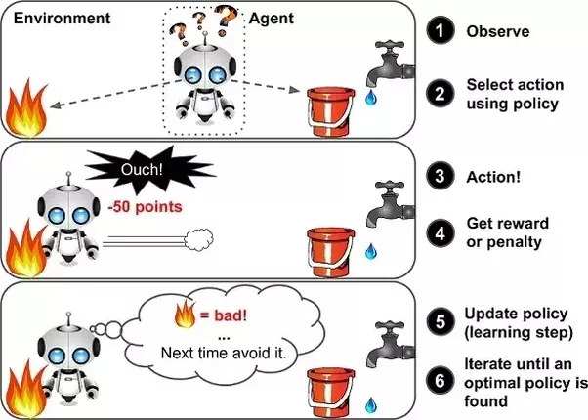

Slide 22
Overview of Reinforcement Learning
In the above example, we can see that the agent is given 2 options i.e., a path with water or a path with fire.
A reinforcement algorithm works to reward a system i.e. if the agent uses the fire path, then the rewards are subtracted, and the agent tries to learn that it should avoid the fire path.
If it had chosen the water path or the safe path then some points would have been added to the reward points, the agent then would try to learn what path is safe and what path isn’t.

Slide 23
Machine Learning Applications
Prediction
Machine learning can also be used in the prediction systems. Considering the loan example, to compute the probability of a fault, the system will need to classify the available data in groups.
Image recognition
Machine learning can be used for face detection in an image as well. There is a separate category for each person in a database of several people.
Speech Recognition
It is the translation of spoken words into the text. It is used in voice searches and more. Voice user interfaces include voice dialing, call routing, and appliance control. It can also be used a simple data entry and the preparation of structured documents.

Slide 24
Machine Learning Applications
Medical diagnoses
ML is trained to recognize cancerous tissues.
Financial industry and trading
companies use ML in fraud investigations and credit checks.

Slide 25
Thanks
Credits: https://towardsdatascience.com/

